Slide 1
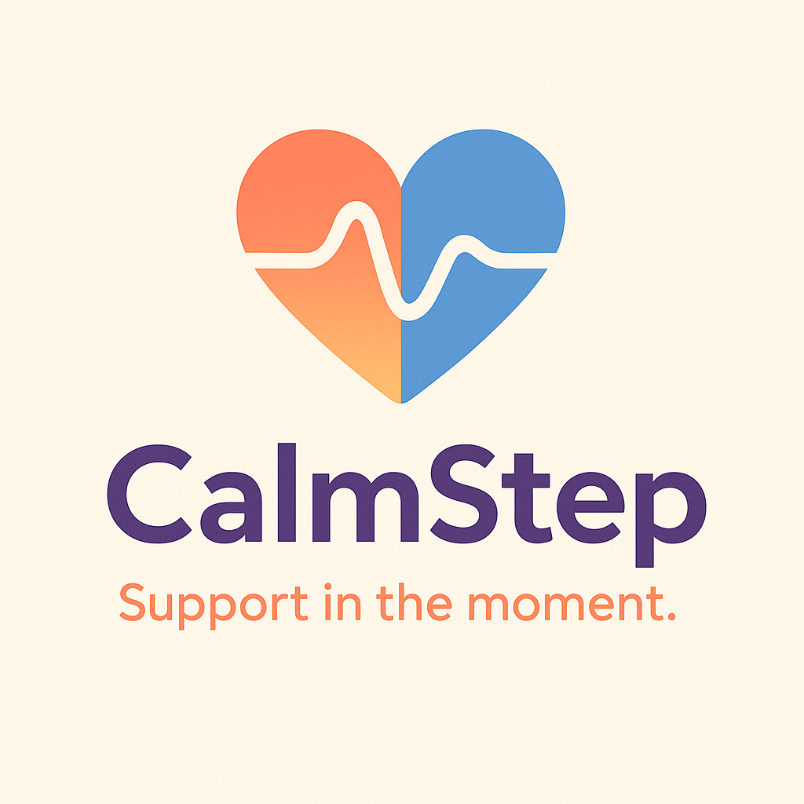
An AI Guided Crisis Support Companion

Slide 2
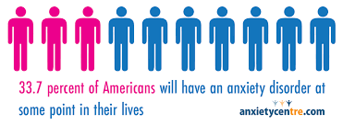
Problem Statement
The Problem
Millions of people struggle with anxiety panic symptoms, or emotional overwhelm, yet over half never received treatment due to stigma, cost, waitlists, or lack of health insurance.. When symptoms hit, people often have no immediate support, just a phone full of apps that aren’t built for in the moment regulation.
Why It Matters
Untreated anxiety and emotional dysregulation can impact work, relationships, school performance, and physical health. People need fast, stigma-free, accessible support they can use anytime, without waiting weeks for an appointment.

Slide 3
Idea 1: AI Guided Crisis Support App
Concept Overview:
A mobile app that helps users navigate panic attacks, anxiety spikes, racing thoughts, or emotional flooding.
Core Features:
Tap → choose what you’re experiencing (panic, racing thoughts, overwhelm, etc.)
App walks you through grounding steps or breathing
Real-time symptom interpretation (“Are you dizzy? Chest tightness? Trouble focusing?”)
AI suggests the correct coping flow (backed by research)
User Benefit:
When you can’t think straight, the app does the thinking for you.

Slide 4
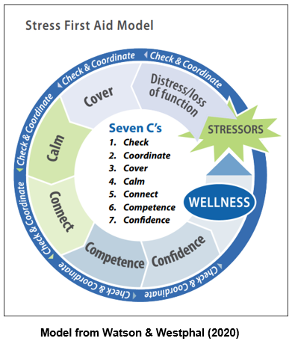
How AI Is Applied
AI Usage (High Level, Non-Clinical):
Classifies the user’s chosen symptoms to match them with the right support flow
Adapts coping steps based on previous user choices (personalized but simple)
Identifies patterns in user logs (optional feature) to recommend tools that work best for them
Important Note:
The AI does not diagnose. It only helps choose the appropriate coping flow based on user input. We can use science backed research and experts in the field to avoid negative results

Slide 5
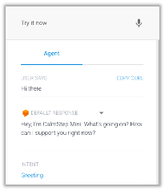
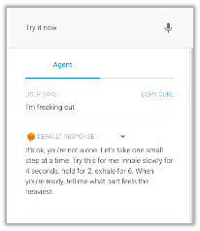
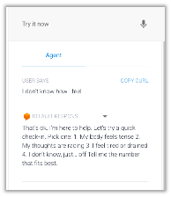
AI Method: How CalmStep Thinks
Uses classification to label a users state: panic spike, rising anxiety, overwhelm, grounding needed
Uses lightweight NLP to interpret short quick user text - “my chest is tight,” “I can’t focus”
Uses a rule based flow engine to pick the right coping script for the user (breathing, grounding)
Makes sure to stay non-clinical (no diagnosis, no therapy advice)

Slide 6
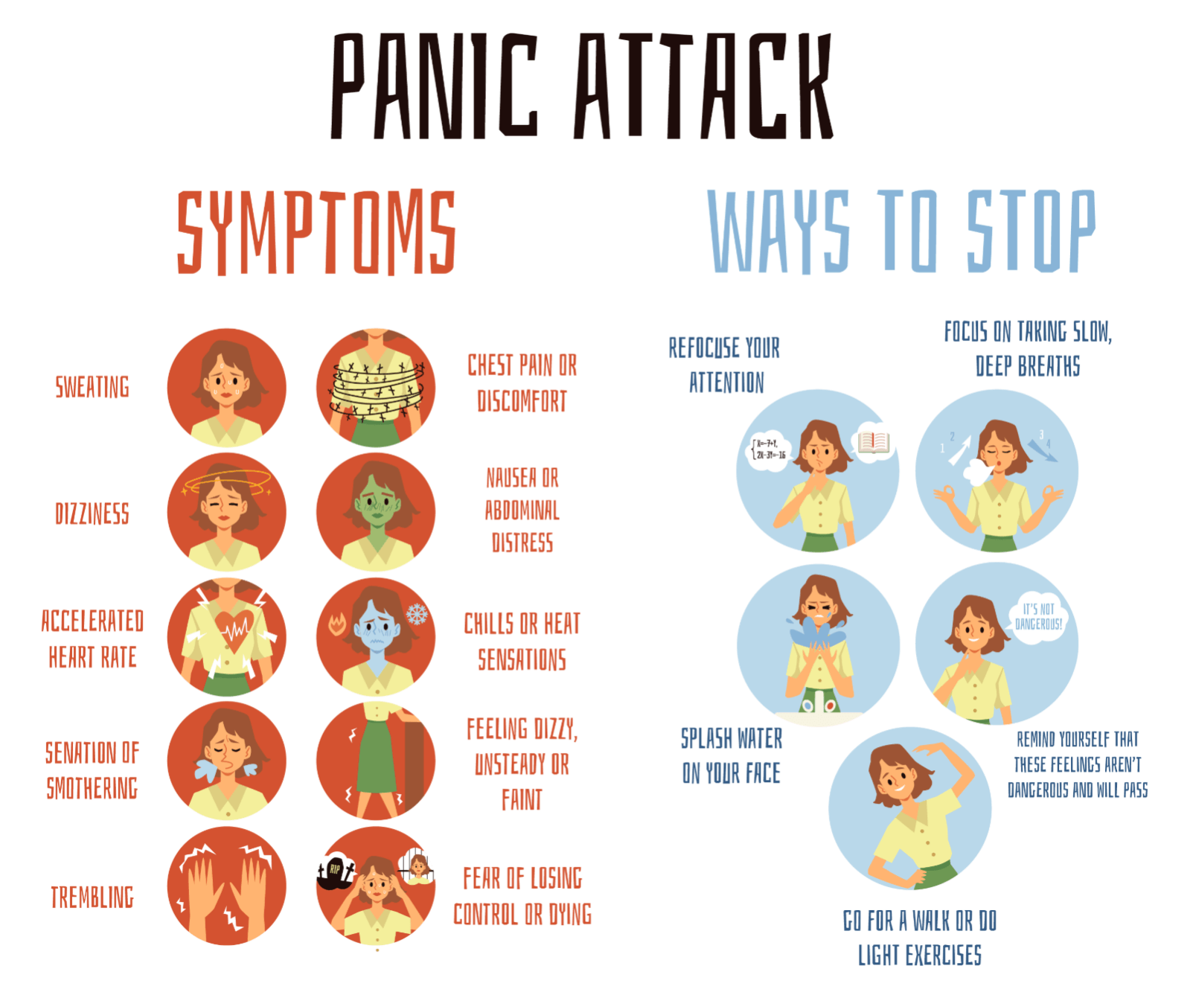
Data Plan: Sources & Types
Open mental-health dataset
  Kaggle, survey-style for stress/anxiety data
Synthetic messages based on public symptom descriptions
  CDC, Mayo Clinic, NIMH
Data types:
  short text, labels (panic/stress/overwhelm)
  timestamps to track patterns
Not a diagnostic tool; must clearly say “support only, not emergency service”
  To stay compliant and transparent

Slide 7
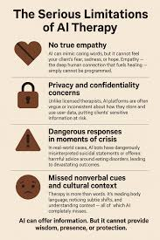
Limitations & Risks
NLP can misread slang or even vague messages
Some users will be in true medical or safety crisis
  Will need to route to 988/emergency
Bias risk: models may perform differently across cultures/languages
  Need to have diverse data & auditing

Slide 8

Ethics Overview
Privacy:
  Collect only what’s needed, no third-party sharing
Transparency:
  Clear messaging that CalmStep is not therapy or a diagnosis
Fairness and Bias:
  Test NLP on diverse language styles
  Monitor misclassification
Safety Boundaries:
  Crisis or medical red flags will route to 988/emergency, not coping flows
User Control:
  Opt-in data, easy delete, no hidden tracking

Slide 9
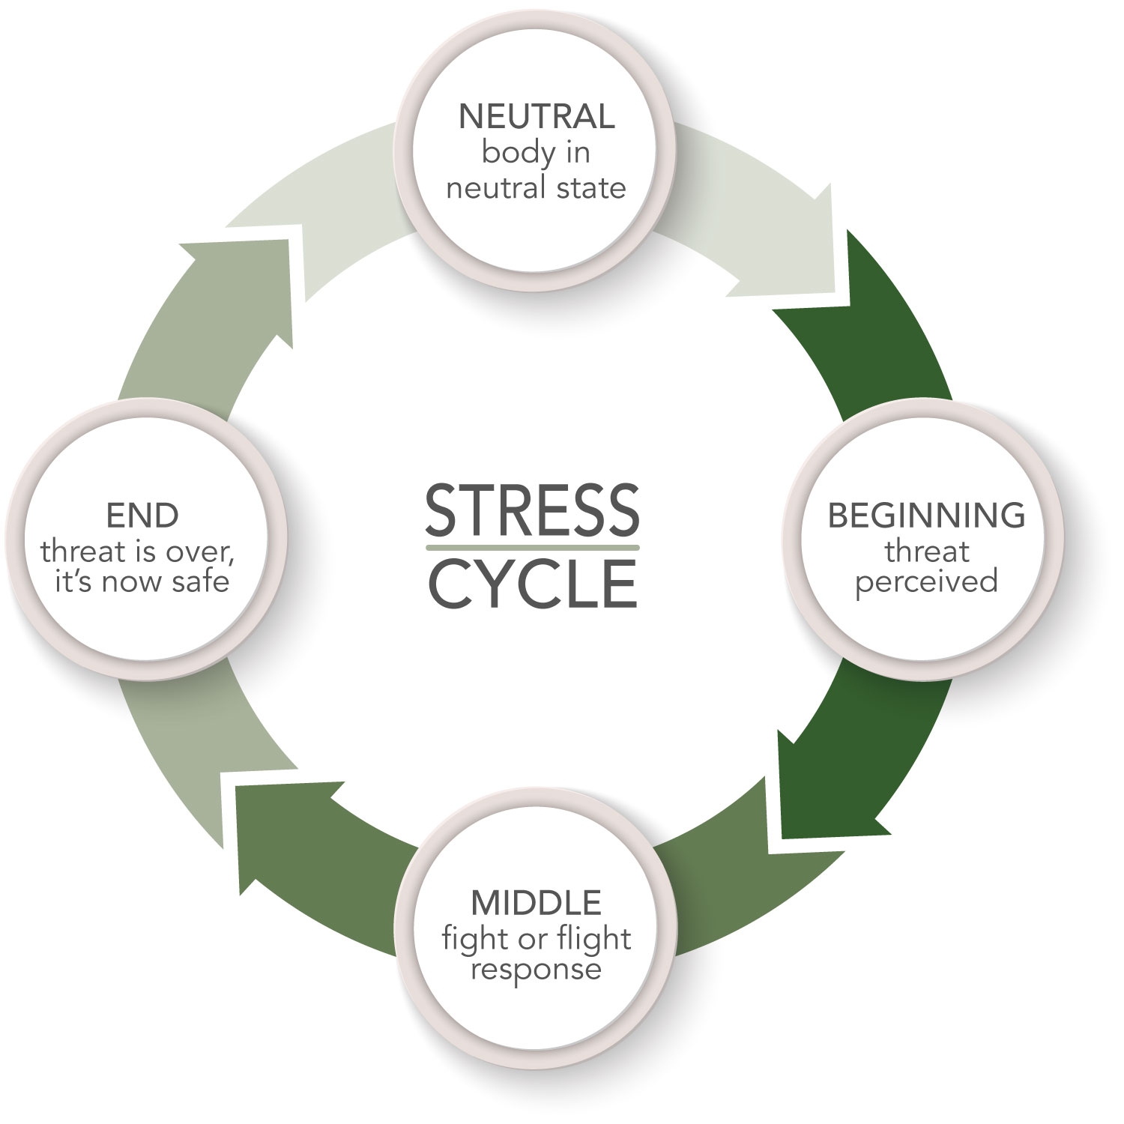
Market Fit & Target Users
Target Users
People who experience panic attacks or even milder symptoms, including racing heart or dizziness
Workers who freeze during high stress moments (like before a big presentation)
An added tool used with therapy in between sessions
Regular people trying to track stress patterns or other anxiety related symptoms

Slide 10
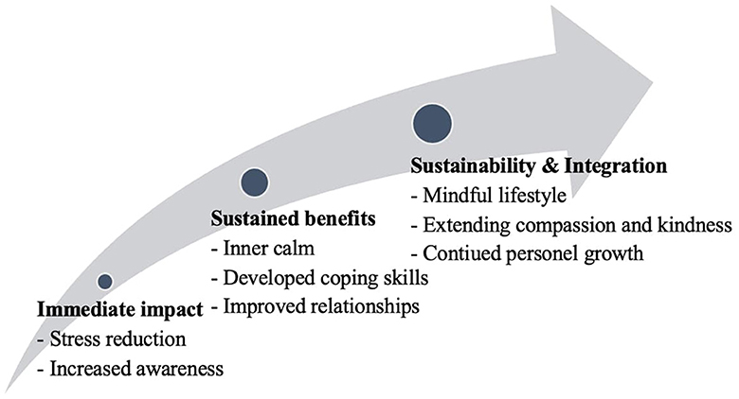
Why CalmStep Works
There are a ton of other mental health apps out there but most of them focus on daily meditation, tracking, or long-term wellness
There’s a big gap for quick accessibly help
CalmStep removes decision fatigue that can stop someone from getting help in the first place
Designed especially for “I’m overwhelmed right now” moments
Competitors (Calm, Headspace, Happify, Moodfit) don’t specialize in acute panic supportPeople with drivers anxiety (on the move)
Any one can use it because everyone has moments when they feel like they lose control and need help now

Slide 11
Ethical Use Statement
CalmStep is an AI-assisted wellness tool designed to support users through moments of sudden panic, anxiety or overwhelm. It does not diagnose conditions, replace therapy, or function as an emergency service. All data collection is options, minimal and under user control. The system uses a simple, explainable AI model and adheres to strict privacy, safety, and fairness guidelines. Any indication of crisis or medical risk redirects users to appropriate emergency resources.

